Slide 1

Obesity Level Estimation Using Proportional Odds Model
Han Gong

Slide 2
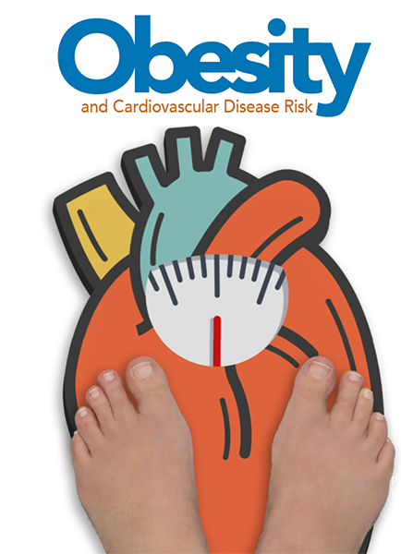
Project Overview
The obesity epidemic has become one of the most serious public health problems globally.
Obesity and overweight are described as "excessive fat accumulation in certain body areas that can be harmful to health" by the World Health Organization(WHO) [1].
According to the research conducted by WHO in 2014, over 1900 million obese adults worldwide, which is double times compared to the number in 1980[1].
Notes:
The obesity epidemic has become one of the most serious public health problems globally. As the pandemic of COVID-19 enforced the practice of social-distancing and remote working, the altered eating behaviors and physical conditions such as longer screen time, intake of high caloric food, and reduced activity frequency may contribute to a higher risk of obesity.

Slide 3
Notes:
As the pandemic of COVID-19 enforced the practice of social-distancing and remote working, the altered eating behaviors and physical conditions such as longer screen time, intake of high caloric food, and reduced activity frequency may contribute to a higher risk of obesity.

Slide 4
Research Question
Question 1: What are some main factors or habits that contribute to a higher risk of obesity?
Question 2: Are the associations between eating habits/lifestyle and obesity differ in gender?

Slide 5
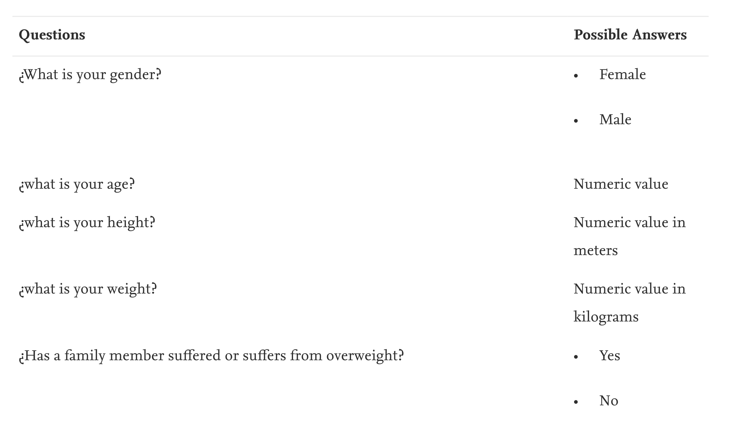
Data
The dataset used in this statistical analysis is accessed via the UCI machine learning public database and collected by a 2018 study on obesity levels estimation based on anonymous survey results collected among individuals from Colombia, Peru, and Mexico [2].
Notes:
The dataset used in this statistical analysis is accessed via the UCI machine learning public database and collected by a 2018 study on obesity levels estimation based on anonymous survey results collected among individuals from Colombia, Peru, and Mexico [2].
data was collected using a web platform with a survey (see Table 1) where anonymous users answered each question, then the information was processed obtaining 17 attributes and 2111 records

Slide 6
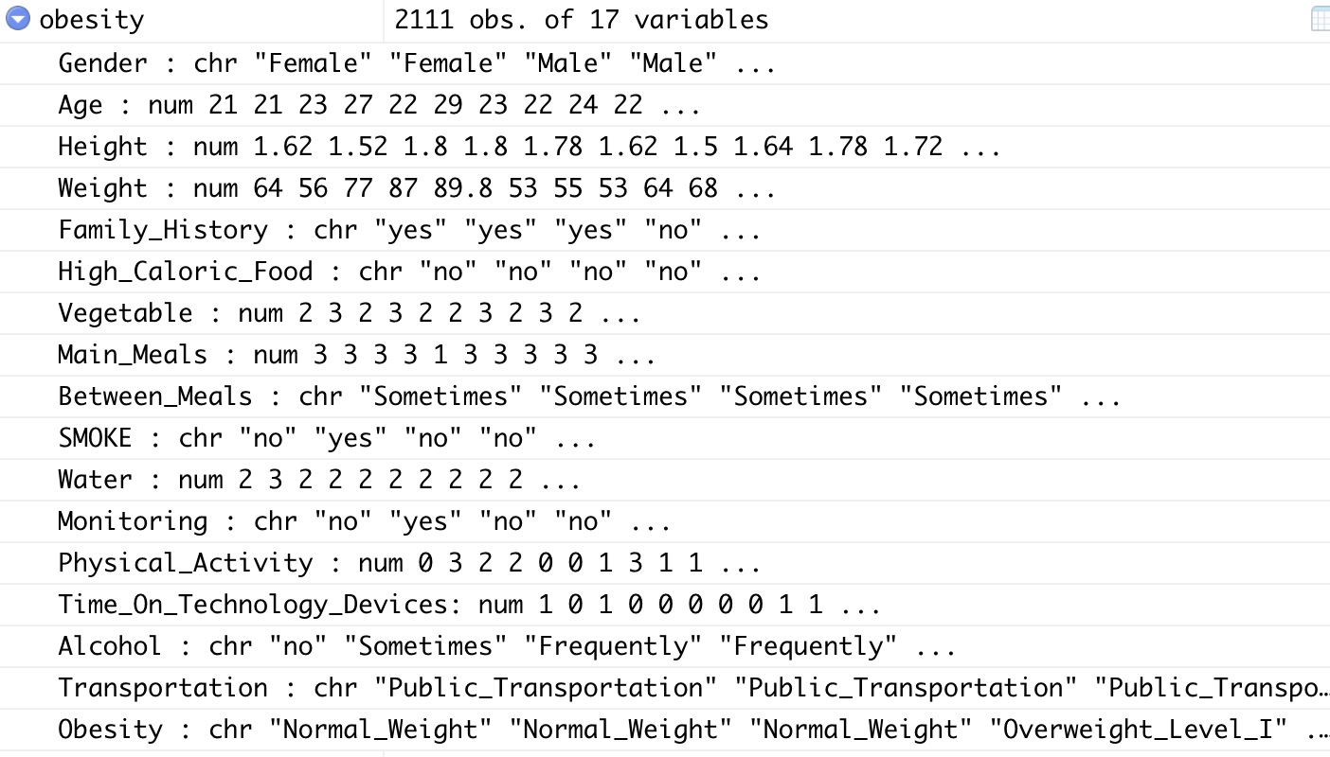
Data Pre-processing
Demographic Information

Slide 7
Data Pre-processing
Eating Habit

Slide 8
Data Pre-processing
Lifestyle

Slide 9
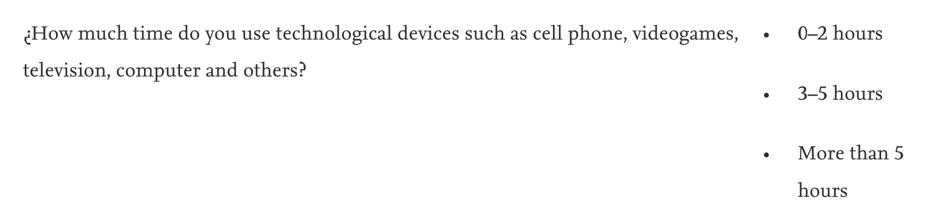
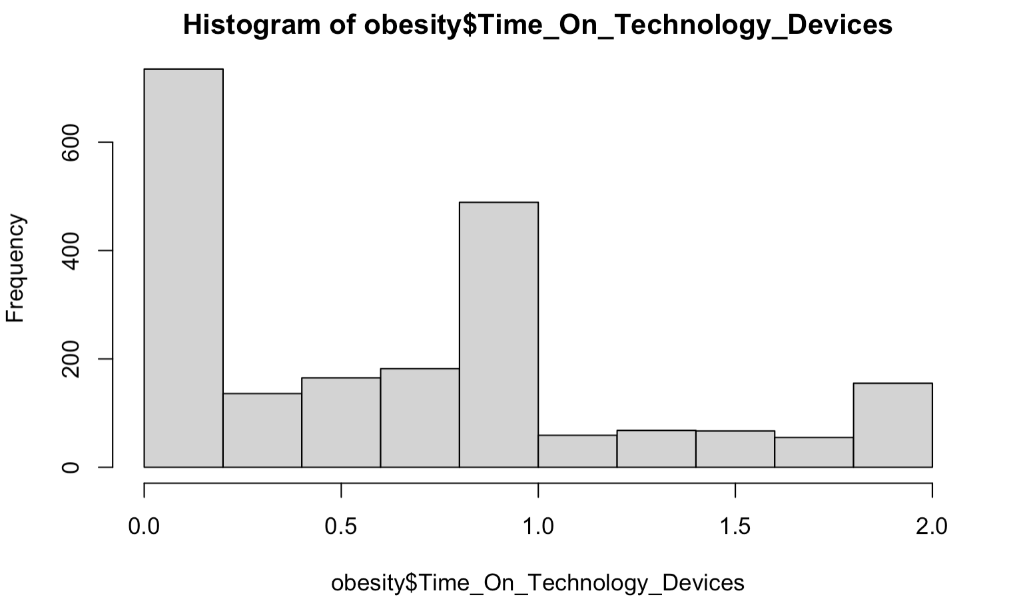
Data Pre-processing
Lifestyle

Slide 10
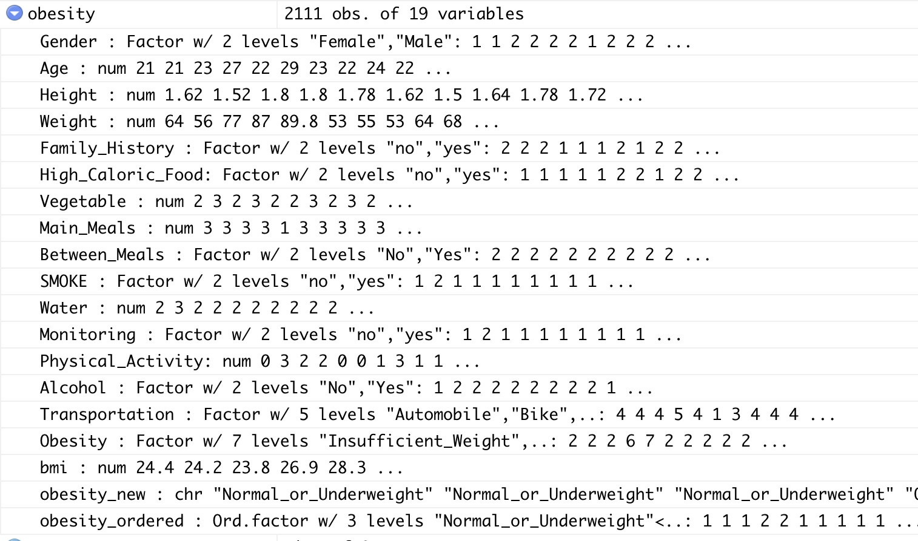
Data Pre-processing
Categorical to Binary
Always → Yes
Frequently → Yes
Sometimes → Yes
No → No

Slide 11
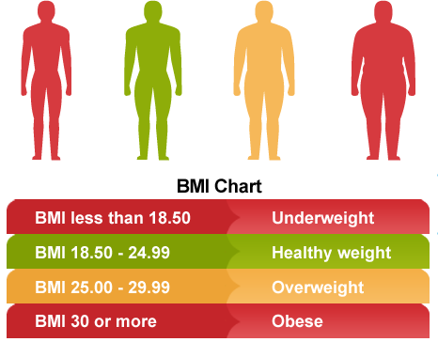
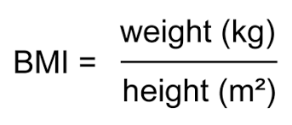
Data Pre-processing

Slide 12
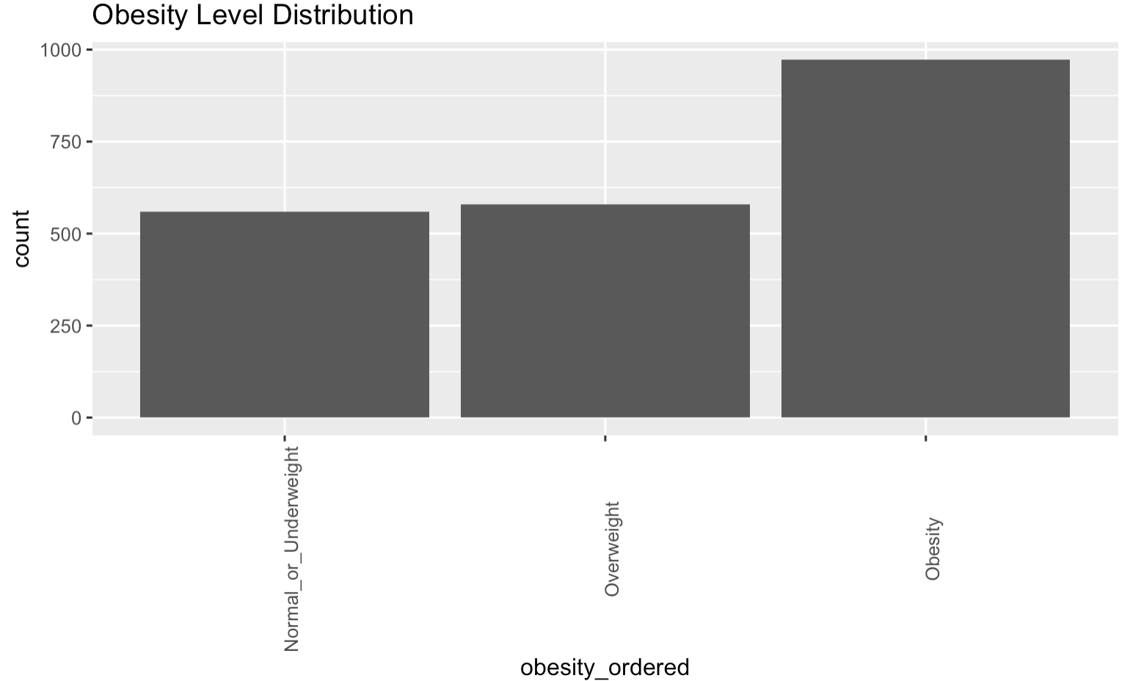
Obesity Level Distribution

Slide 13
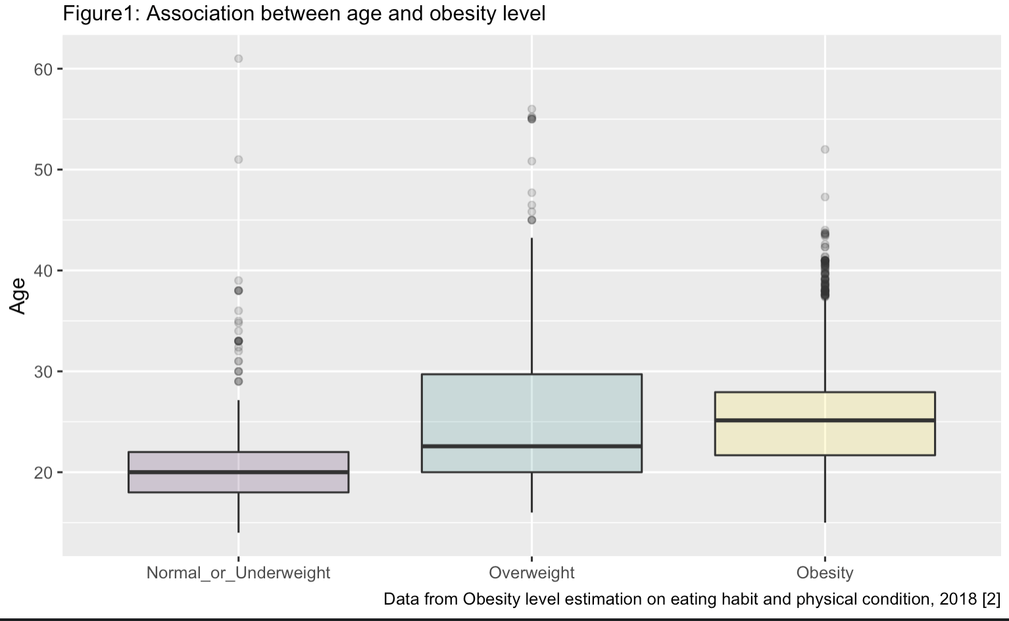
Age vs. Obesity Level
The likelihood of becoming overweight and obese increases as age increases
Notes:
Compared to the normal and overweight category, the increase in the average population age in the obesity category explains obesity as an age-related disease. The increasing risk that corresponds to aging may be explained by hormonal changes, decreases in metabolism, and a less active lifestyle. However, as the dataset's surveyed population is highly skewed towards teenagers and university students, the significance of aging in obesity development needs to be examined in the final model.

Slide 14
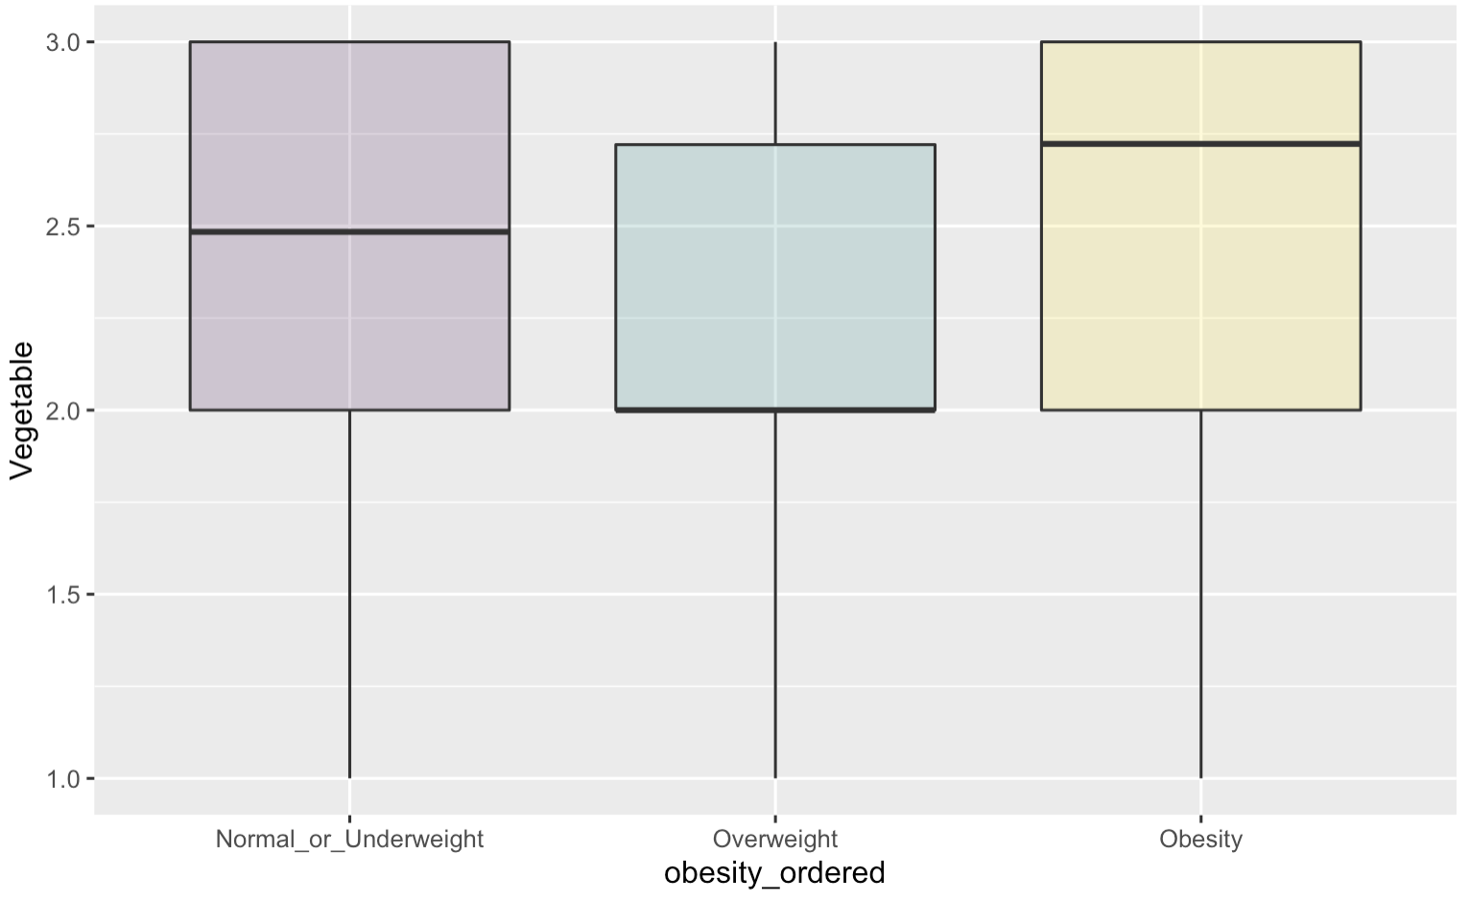
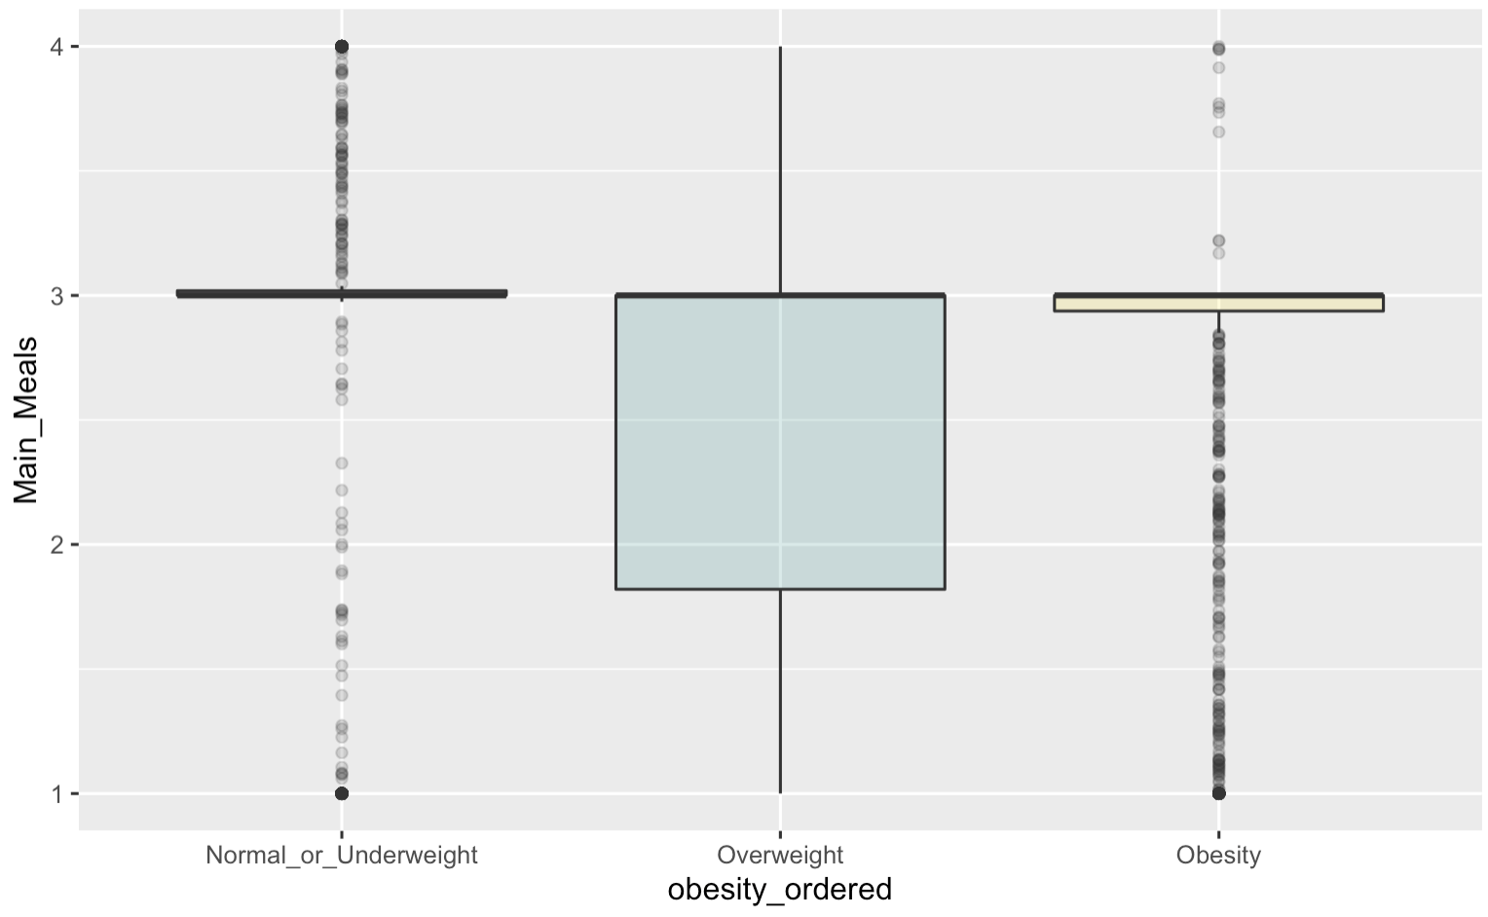
Eating Habit vs. Obesity Level
Notes:
Very clustered, no significant trend involved.
It is also worth mentioning that the association between number of meals and vegetable consumption can be tricky, since people who suffer from exceeded weight probability eat less meals per day to control weight

Slide 15
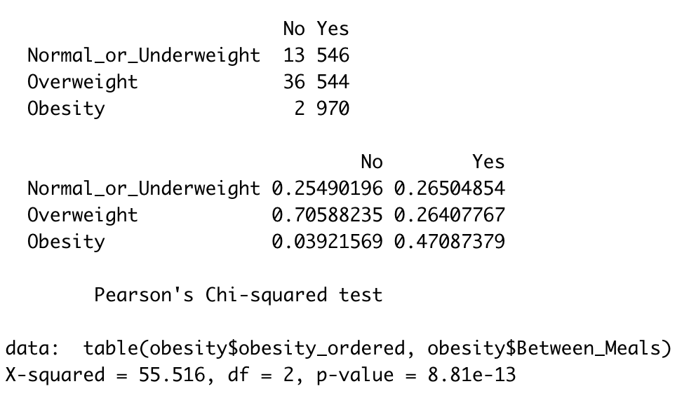
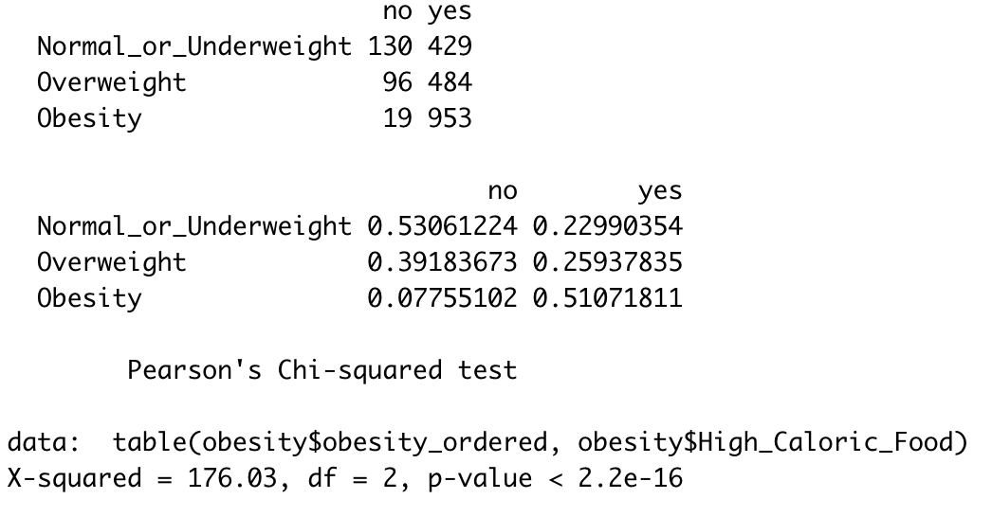
Eating Habit vs. Obesity Level
Between Meal Food Consumption
Intake of Energy-dense Food

Slide 16
Eating Habit vs. Obesity Level
Between Meal Food Consumption
Intake of Energy-dense Food

Slide 17
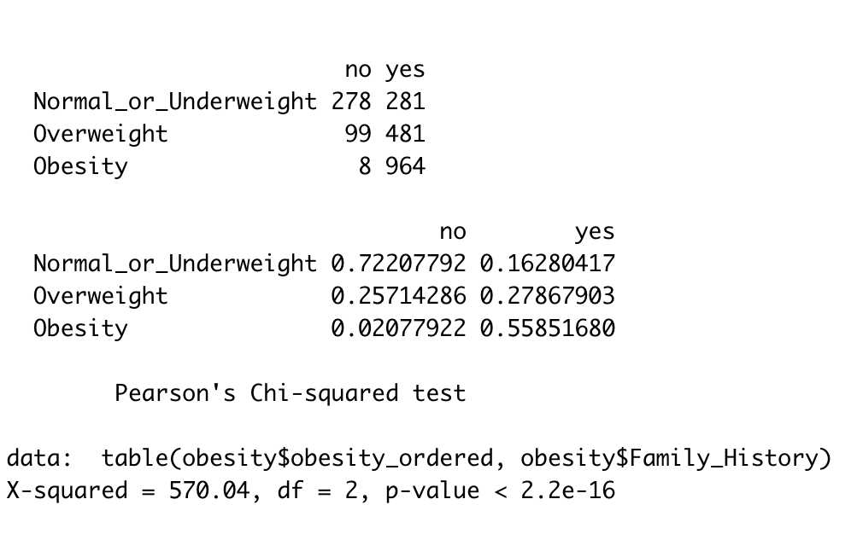
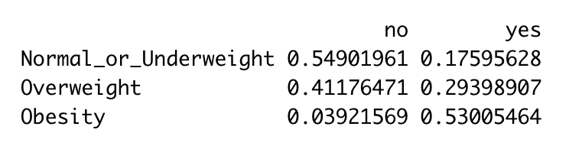
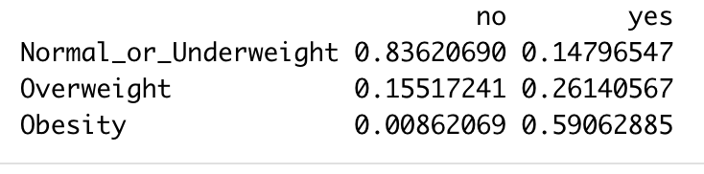
Family History vs. Obesity Level
Male
Female
-- In the overall sample population, the chance of overweight and obese for people with family obesity records is three times higher than those without such histories
Notes:
demonstrates the conditional probability of overweight and obese, given whether individuals have family members suffering from exceeded body weights. In the overall sample population, the chance of overweight and obese people with family obesity records is three times higher than those without such histories.
Although family history is a notable risk factor in both female and male populations, females have significantly higher rates of obesity if their family members experience obesity. In comparison, males have higher rates of overweight in the same condition.

Slide 18
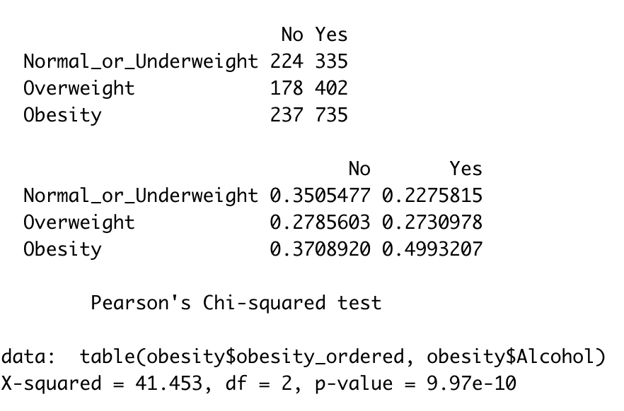
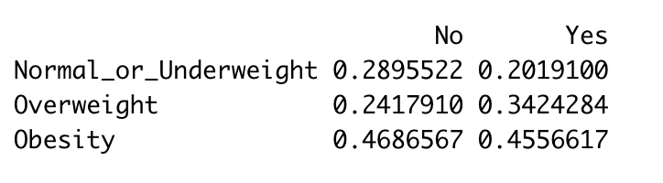
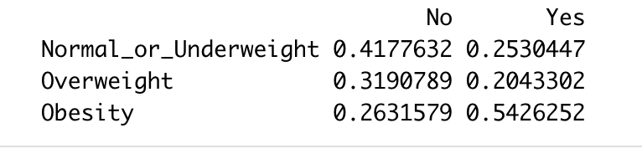
Alcohol vs. Obesity Level
Male
Female

Slide 19

Alcohol vs. Obesity Level
Male
Female
-- Drinking is another risk factor
-- Females are more easily influenced by alcohol consumption in terms of obesity risk

Slide 20
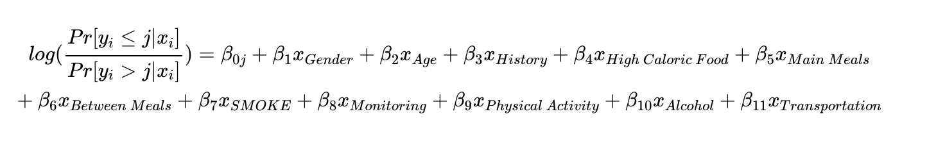
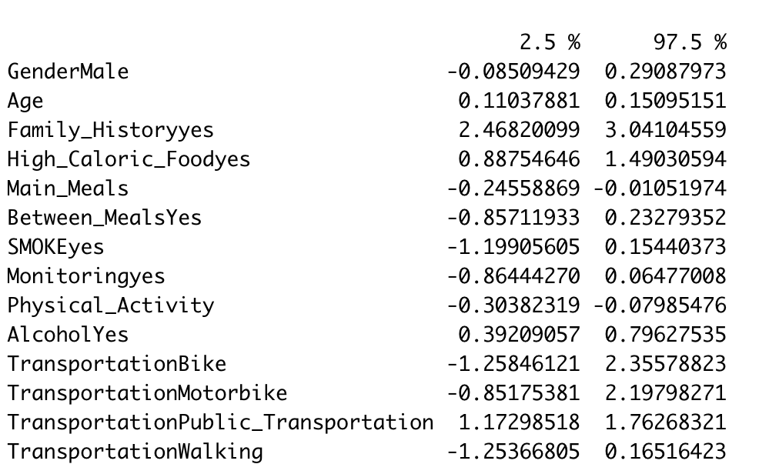
Model Selection

Slide 21
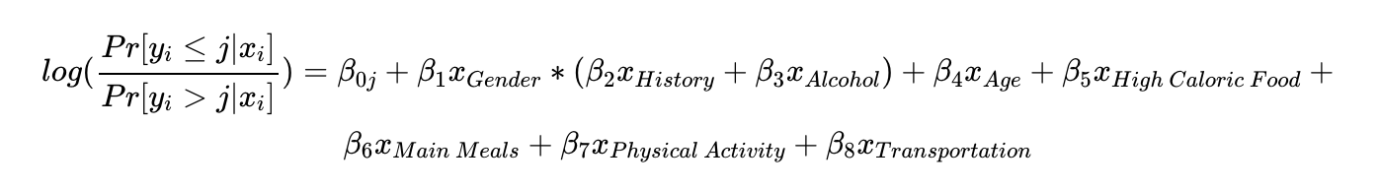
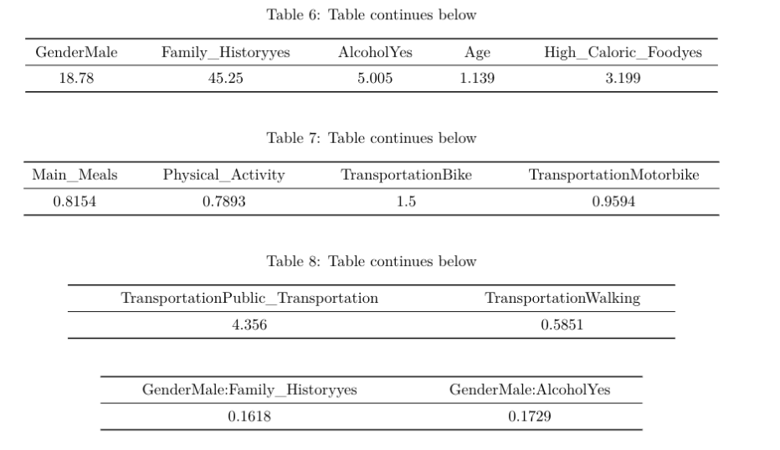
Model Selection

Slide 22
Interesting Findings
Normal or Underweight
Overweight
Obesity
1. Keeping everything else the same, the estimated odds that individuals who self report as having high caloric food eating habit is in the obesity direction rather than the normal or underweight direction is 3.2 times the estimated odds for those who don’t.
2. Keeping everything else the same, one-unit increase in age is corelated with 13% increase in the odds of falling in obesity direction rather the normal direction
3. Keeping everything else the same, one-unit increase in daily physically exercise time will result in 21% decrease in the odds of falling in obesity direction rather the normal direction

Slide 23
Interesting Findings
Normal or Underweight
Overweight
Obesity
4. Keeping everything else the same, the estimated odds that male with family history of obesity is in the obesity direction rather than the normal or underweight direction is 7.2 (exp(3.8 – 1.82) = 7.24) times the estimated odds for males who don’t.
5. Keeping everything else the same, the estimated odds that females with family history of obesity is in the obesity direction rather than the normal or underweight direction is 28 (exp(1.6 + 1.75) = 28.5) times the estimated odds for females who don’t.

Slide 24
Limitation
To DO
1. Volunteer Bias
Survey-based data
Population centered adolescents and university students
2. Confounding Variables
Social and economic factors
1. Model Assessment
2. Transformation

Slide 25
Limitation
1. Volunteer Bias
2. Confounding Variables

